Slide 1
GIT
VERSION CONTROL SYSTEM

Slide 2
Git - VCS
What is Git?
Setup Git
Git Flow
Clone source code
Commit
Fetch
Pull (Update)
Push
Handling conflict
Branch
Merge
Rebase
Pull Request
Tag
Stash

Slide 3
What is GIT?
Version Control System (VCS) is a software that helps software developers to work together and maintain a complete history of their work.
Git is a free and open source distributed version control system designed to handle everything from small to very large projects with speed and efficiency.

Slide 4
Setup GIT
https://git-scm.com/book/en/v2/Getting-Started-Installing-Git
Install via Homebrew:
- Install Homebrew from this URL: https://brew.sh/index_vi.html
- Install git: brew install git

Slide 5
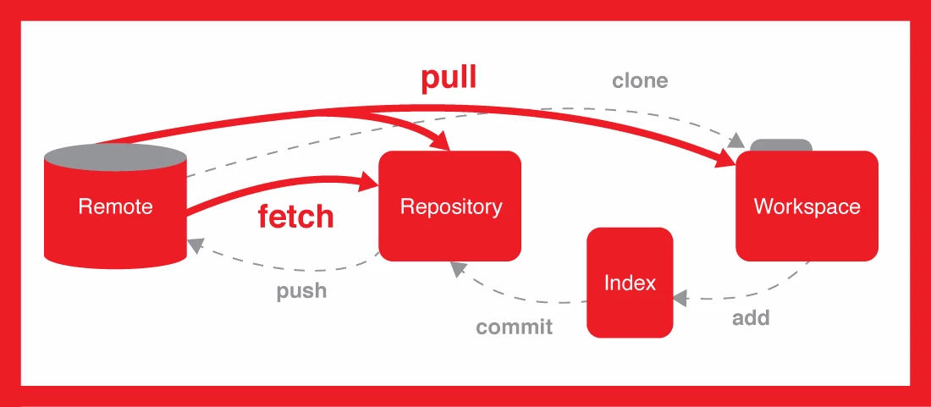
GIT Flow

Slide 6
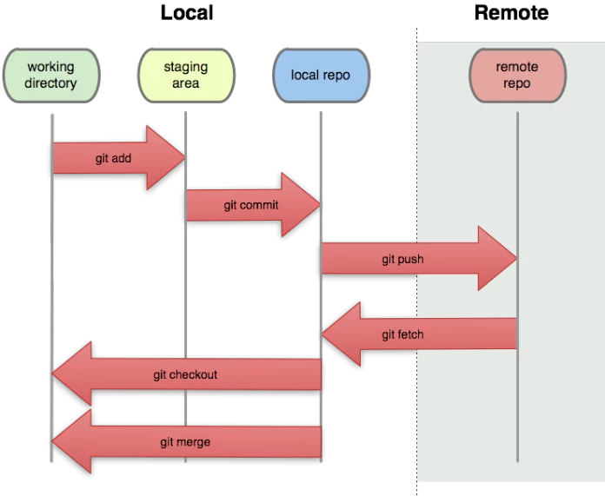
Local repository And Remote repository

Slide 7
Usage
Command line
https://axonvibe.atlassian.net/wiki/spaces/~thuy.nguyen/pages/300122316/Command+Line
Source Tree
https://axonvibe.atlassian.net/wiki/spaces/~thuy.nguyen/pages/300122320/Source+Tree
IntelliJ
https://axonvibe.atlassian.net/wiki/spaces/~thuy.nguyen/pages/301105153/IntelliJ

Slide 8
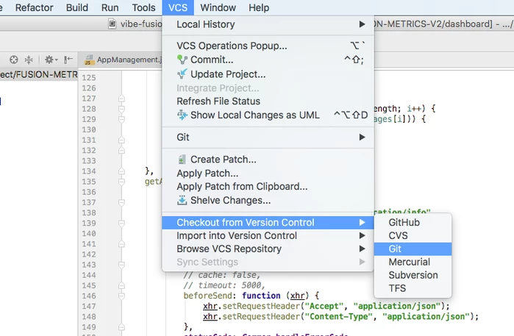
Clone Source Code

Slide 9
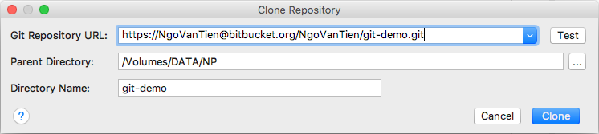
Clone Source Code

Slide 10
Commit Code
Stores the current contents of the index in a new commit along with a log message from the user describing the changes.

Slide 11
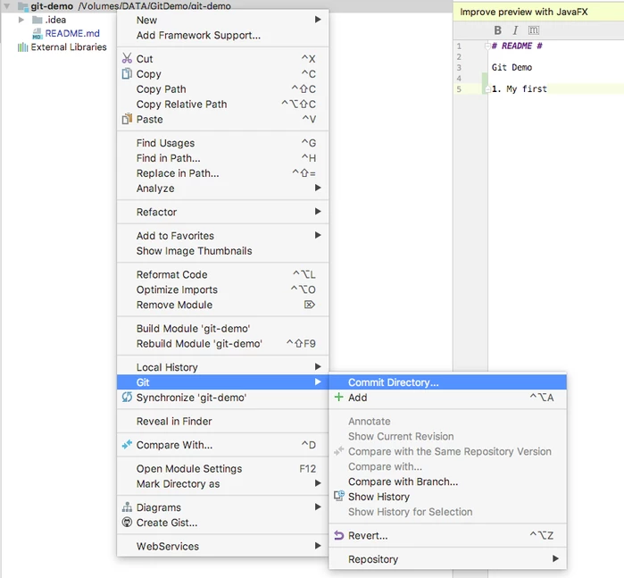
Commit Code

Slide 12
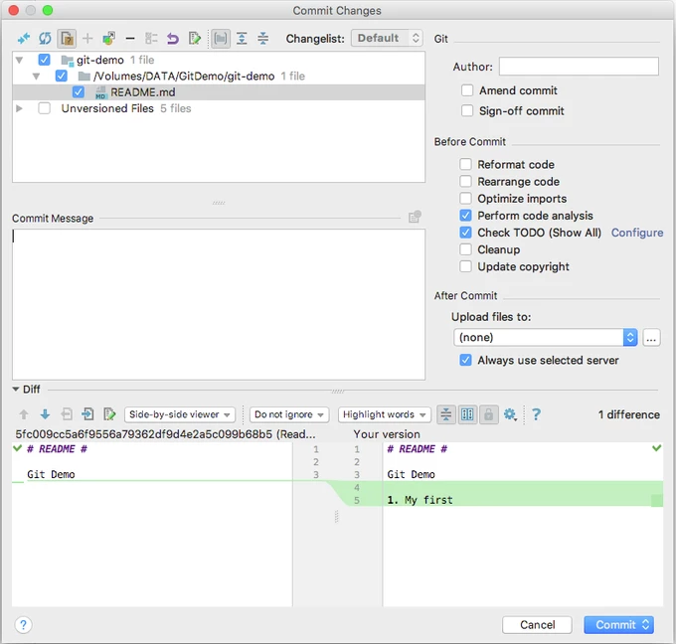
Commit Code

Slide 13
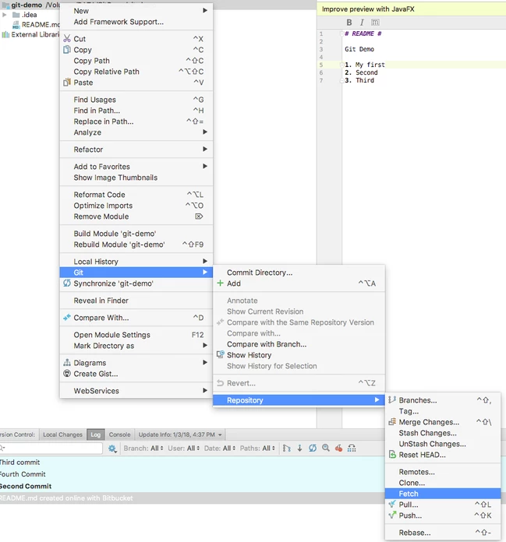
Fetch

Slide 14
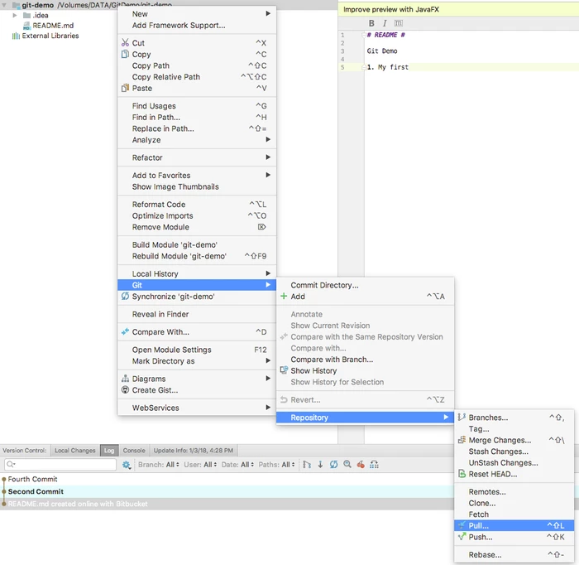
Pull (Update)

Slide 15
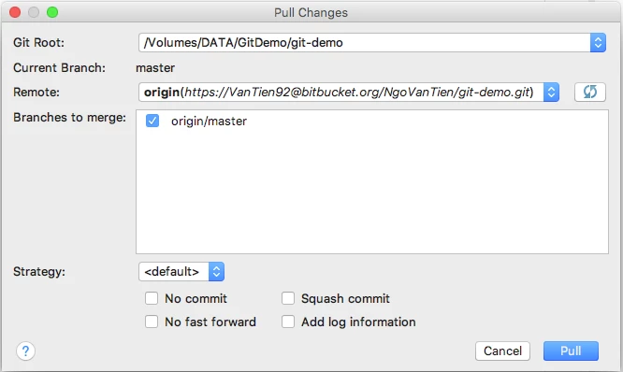
Pull (Update)

Slide 16
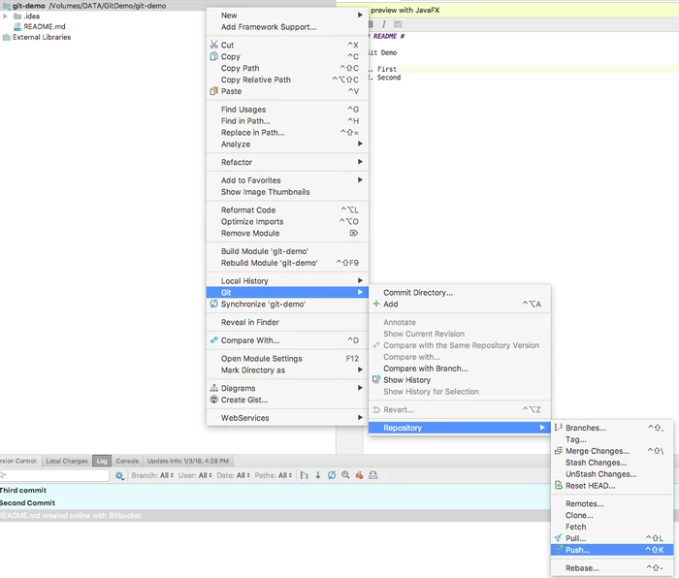
Push

Slide 17
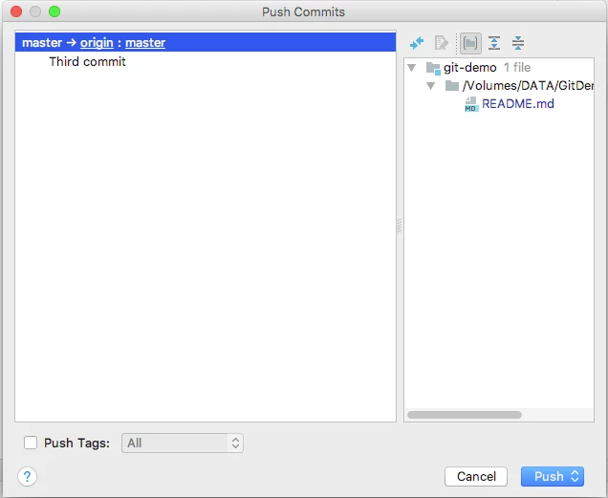
Push

Slide 18
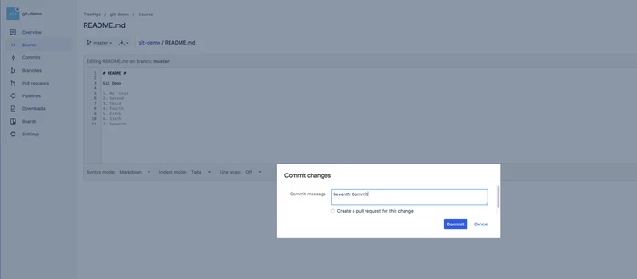
Handling Conflict
User 1 commit 2 line (10 & 11) from Bitbucket server

Slide 19
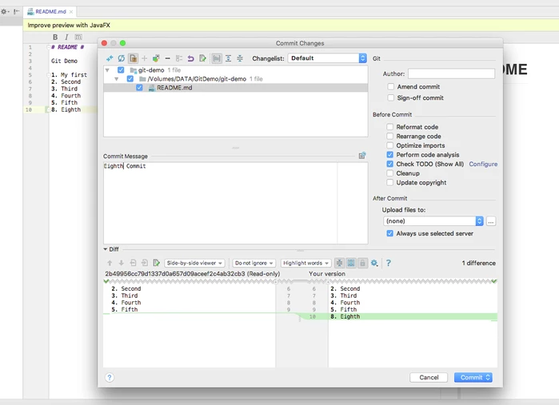
Handling Conflict
User 2 commit 1 line (10) from other tool (IntelliJ)

Slide 20
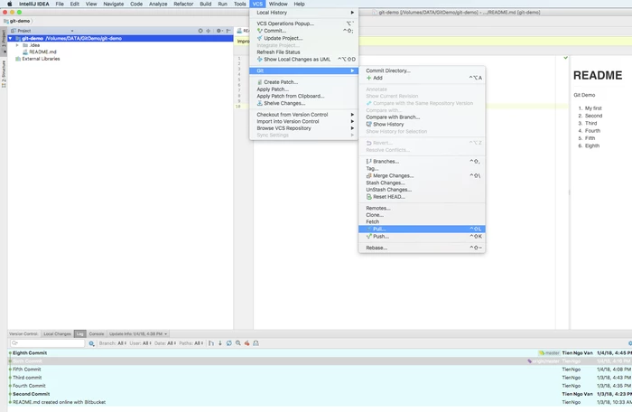
Handling Conflict
User 2 pull code from server

Slide 21


Slide 22
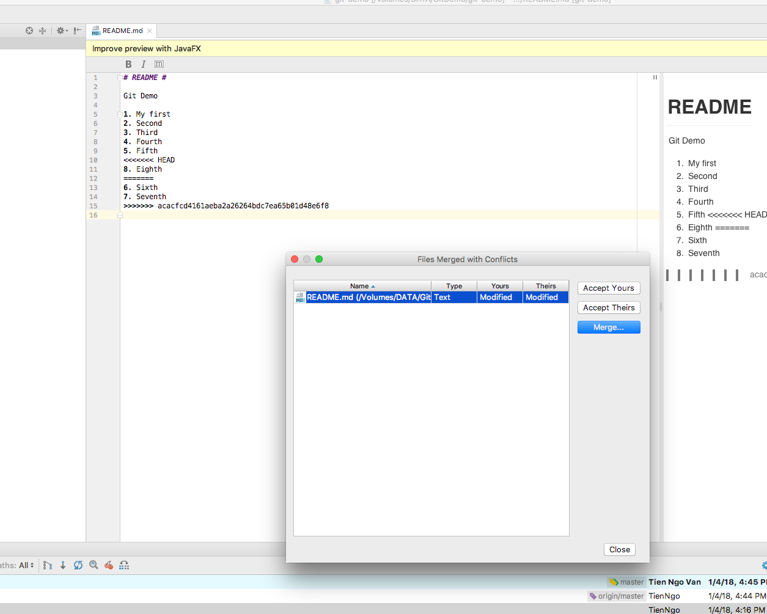
Handling Conflict
Code will be conflict

Slide 23
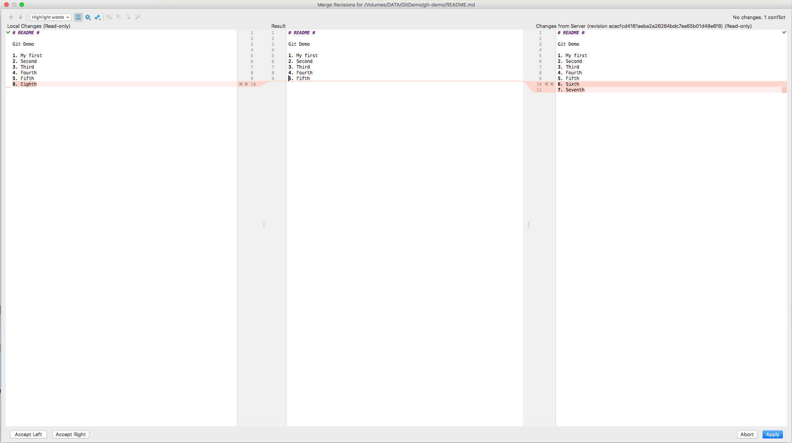
Handling Conflict
Click Merge...

Slide 24
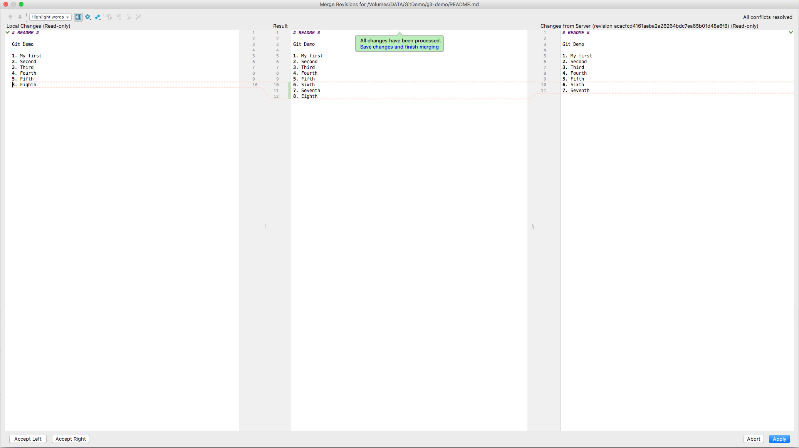
Handling Conflict
Alert will be shown when all conflict resolved

Slide 25
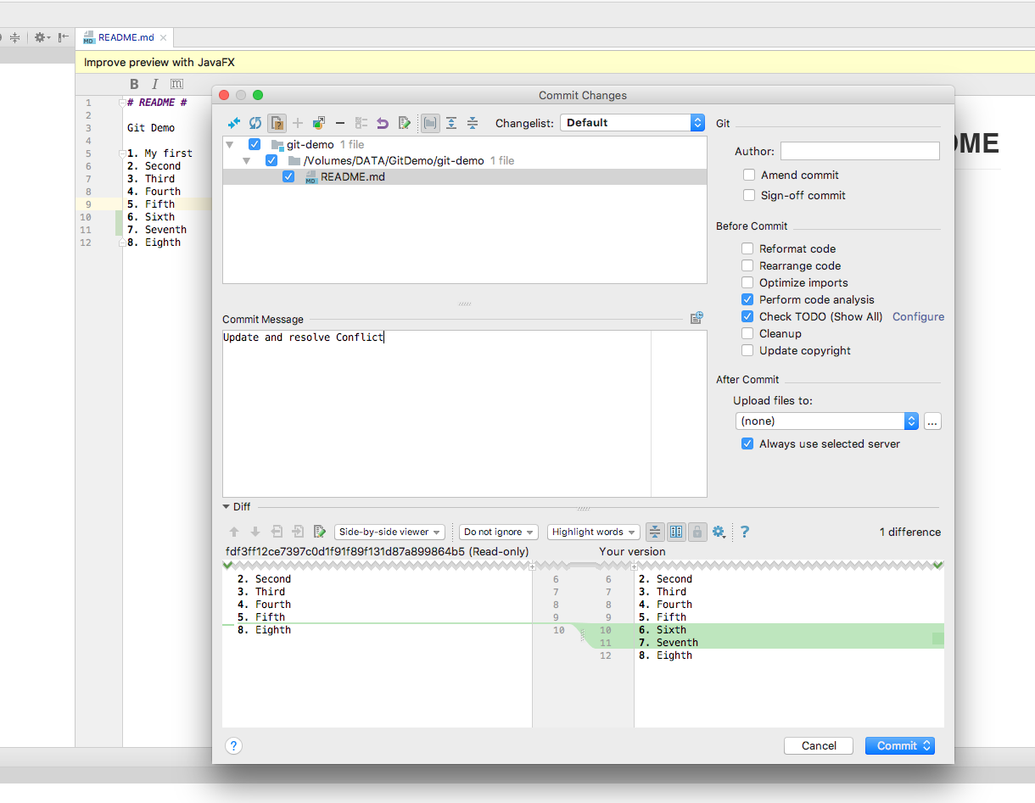
Handling Conflict

Slide 26
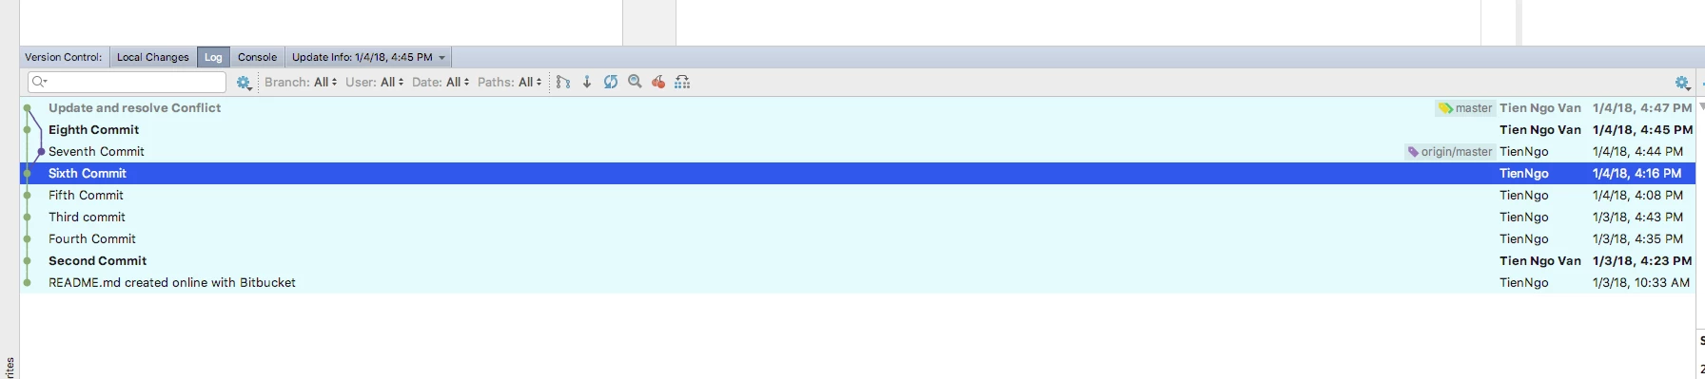
Handling Conflict

Slide 27
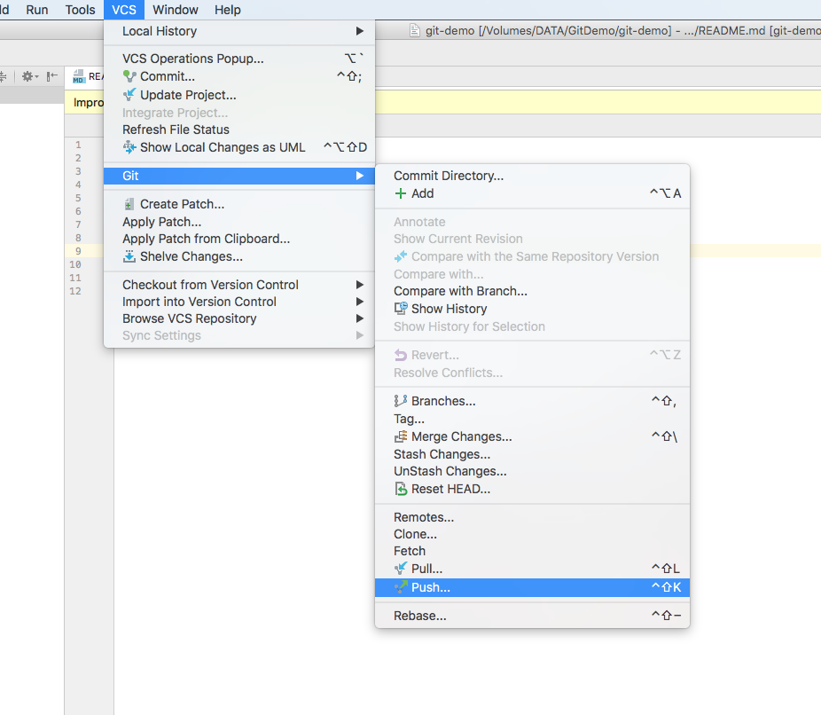
Handling Conflict

Slide 28
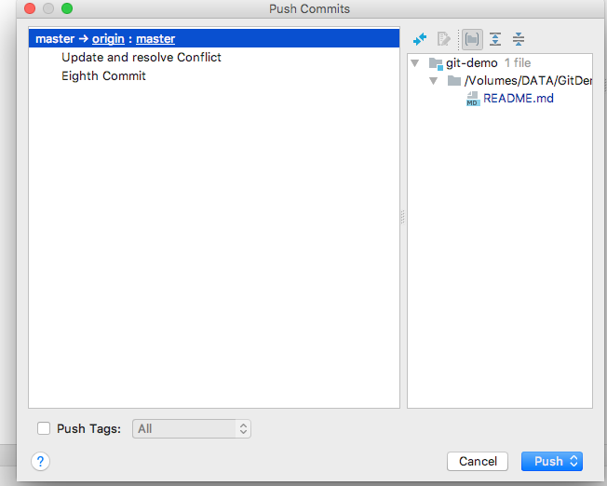
Handling Conflict

Slide 29
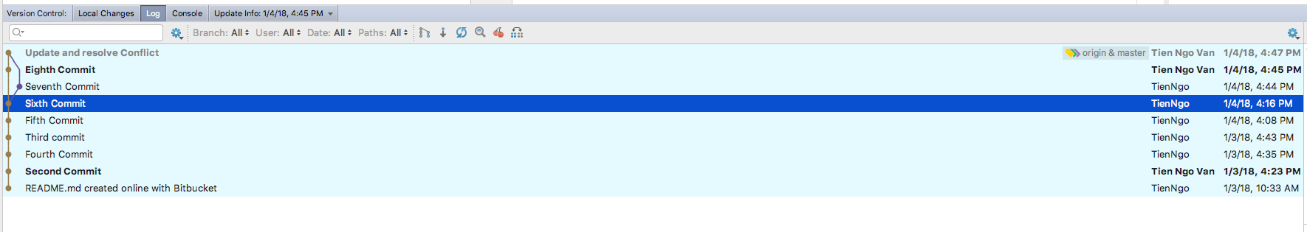
Handling Conflict

Slide 30
Branch
Branching is a feature available in most modern version control systems. Branching is a feature available in most modern version control systems

Slide 31
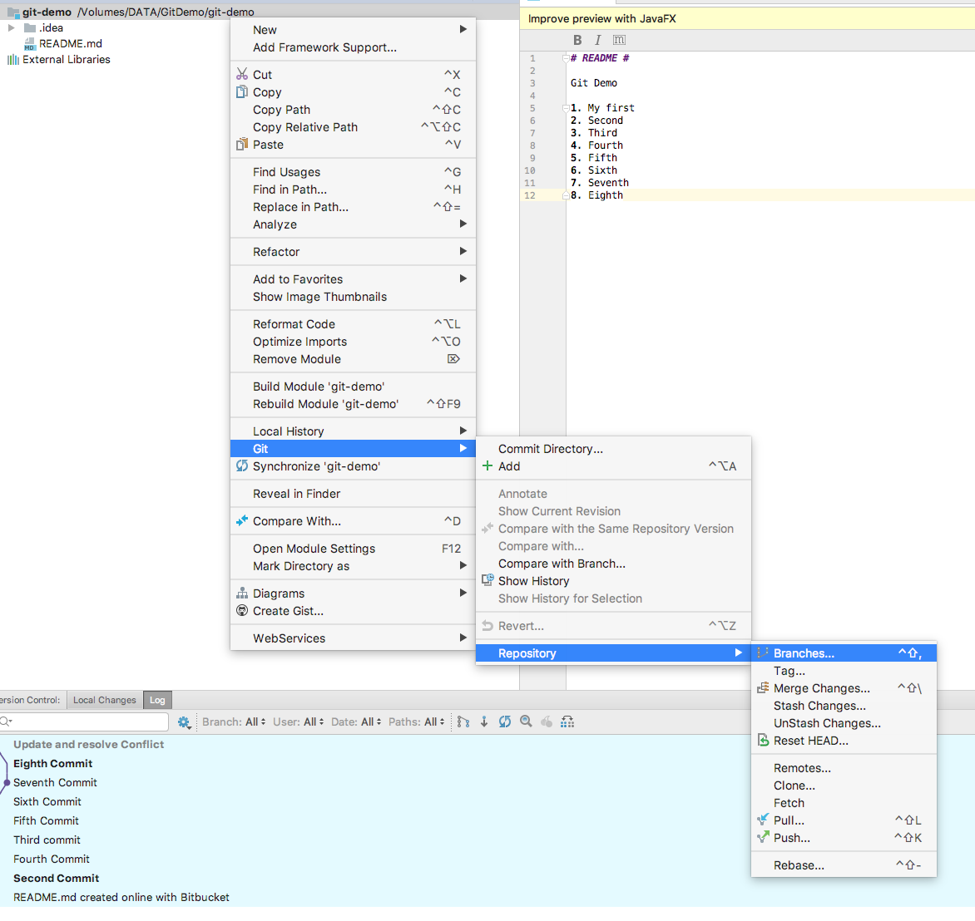
Branch
Create Branch

Slide 32
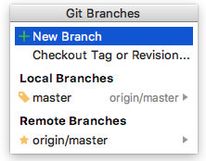
Branch
Create Branch

Slide 33
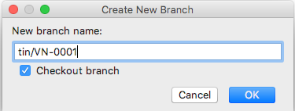
Branch
Create Branch

Slide 34
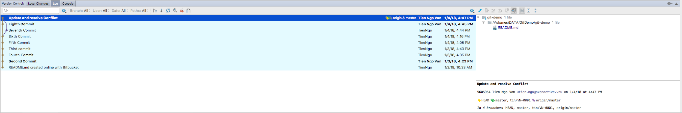
Branch
Create Branch

Slide 35
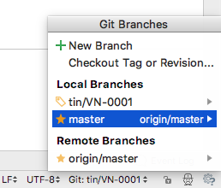
Branch
Switch between branches

Slide 36
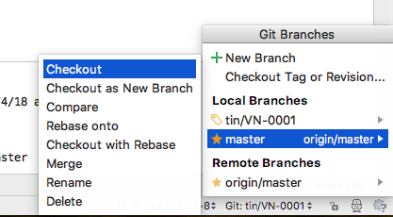
Branch
Switch between branches

Slide 37
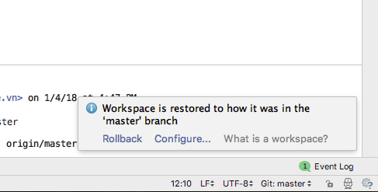
Branch
Switch between branches

Slide 38
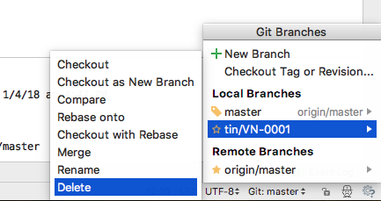
Branch
Delete a branch

Slide 39
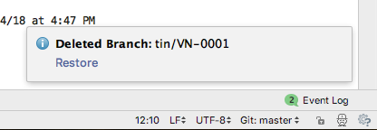
Branch
Delete a branch

Slide 40
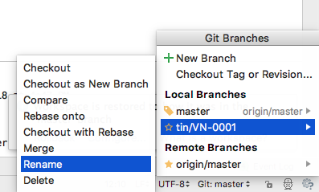
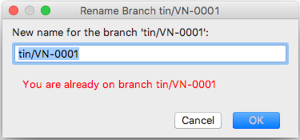
Branch
Rename a branch

Slide 41
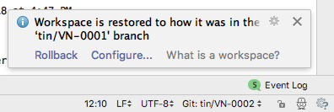
Branch
Rename a branch

Slide 42
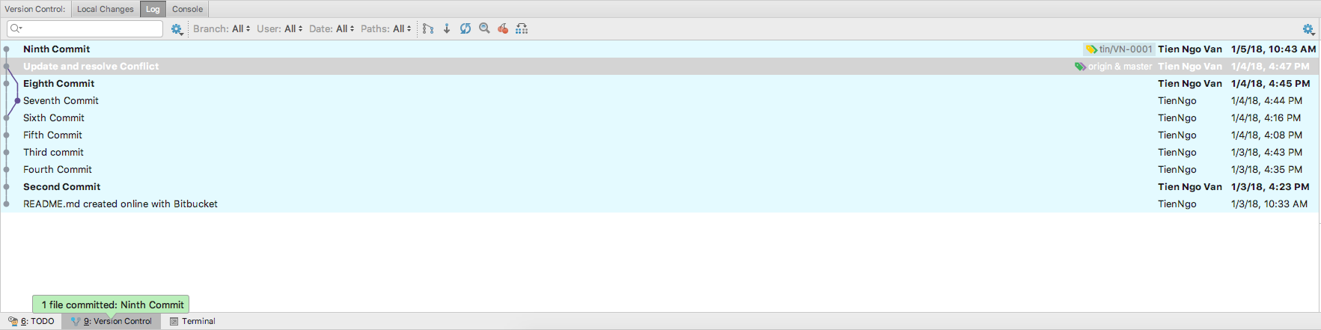
Merge
User 1 create a new branch "tin/VN-0001"
User 1 working and commit on it.

Slide 43
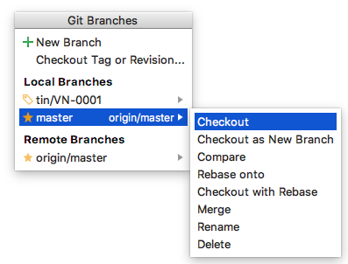
Merge
User 1 check out to a branch want to merge code into. Ex: master

Slide 44
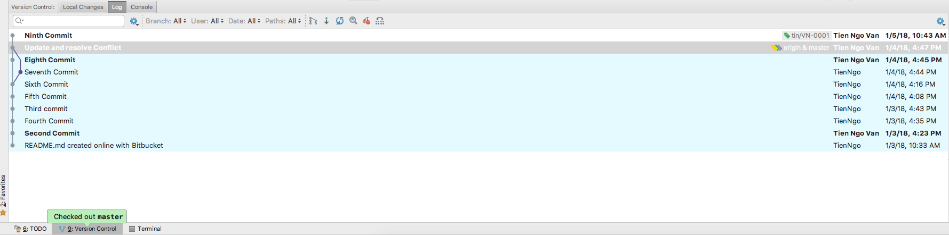
Merge
Notes: Yellow label

Slide 45
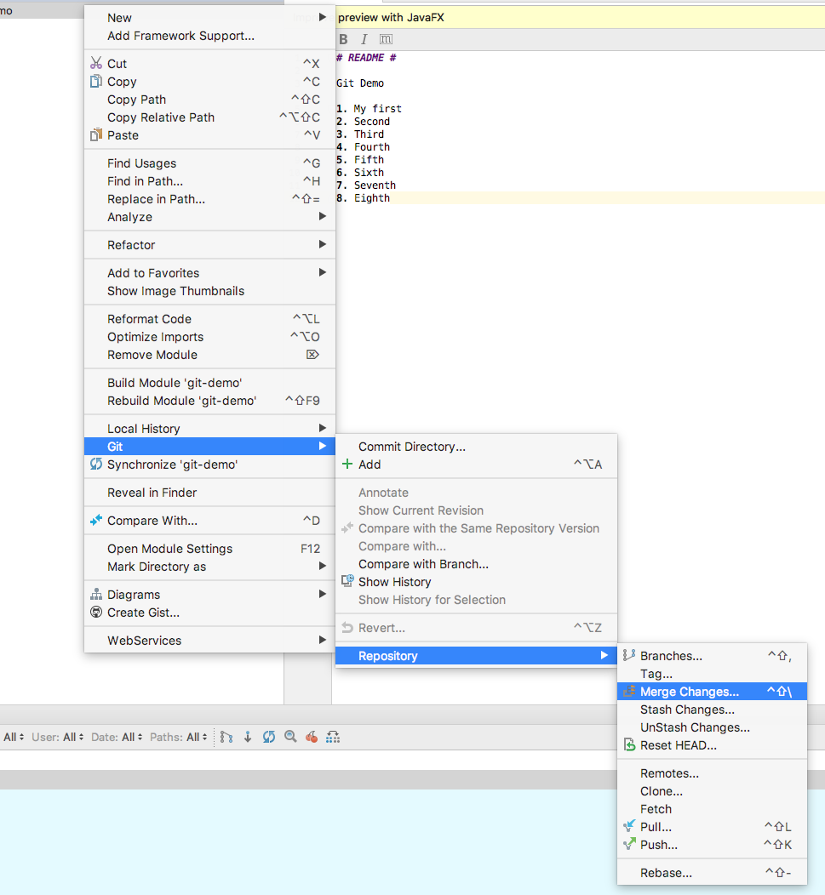
Merge
Select Merge Changes...

Slide 46
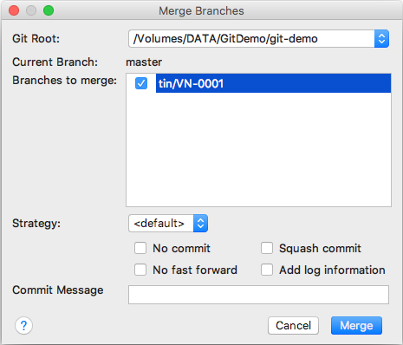
Merge
Select branch want to merge

Slide 47
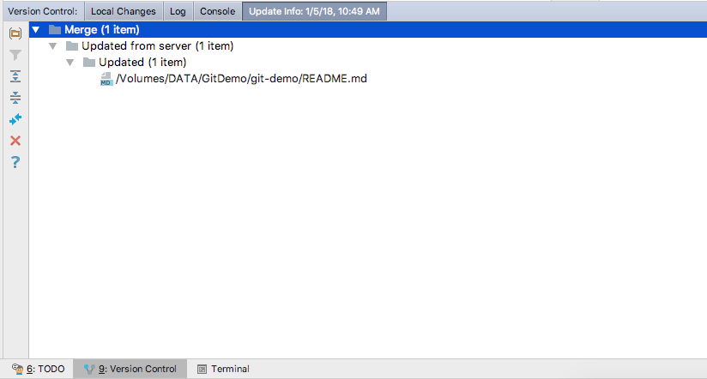
Merge
Resolve conflict if this step has conflict.

Slide 48
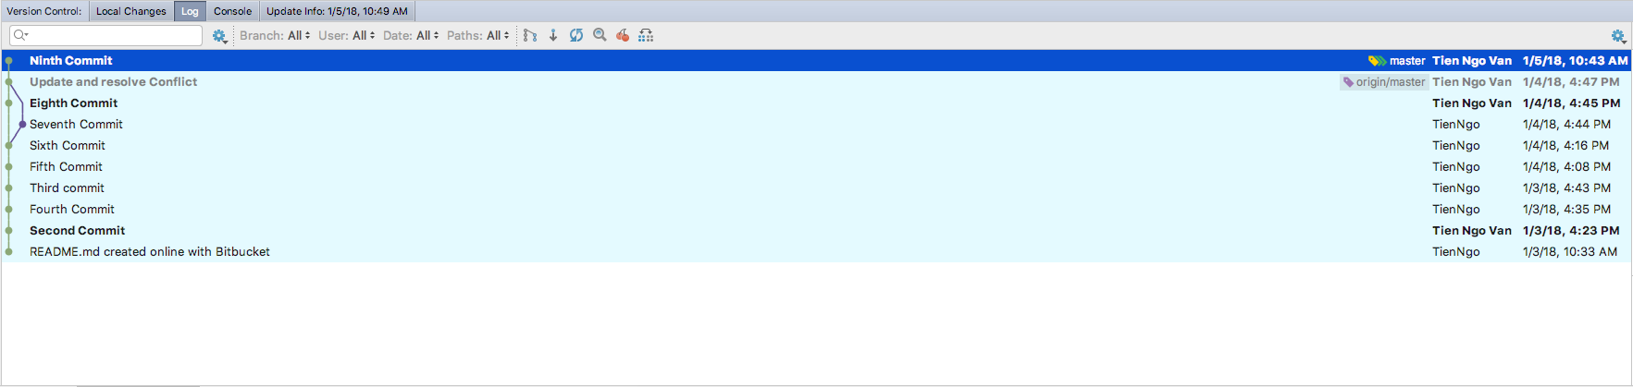
Merge
Code is merged from "tin/VN-0001" to "master"

Slide 49
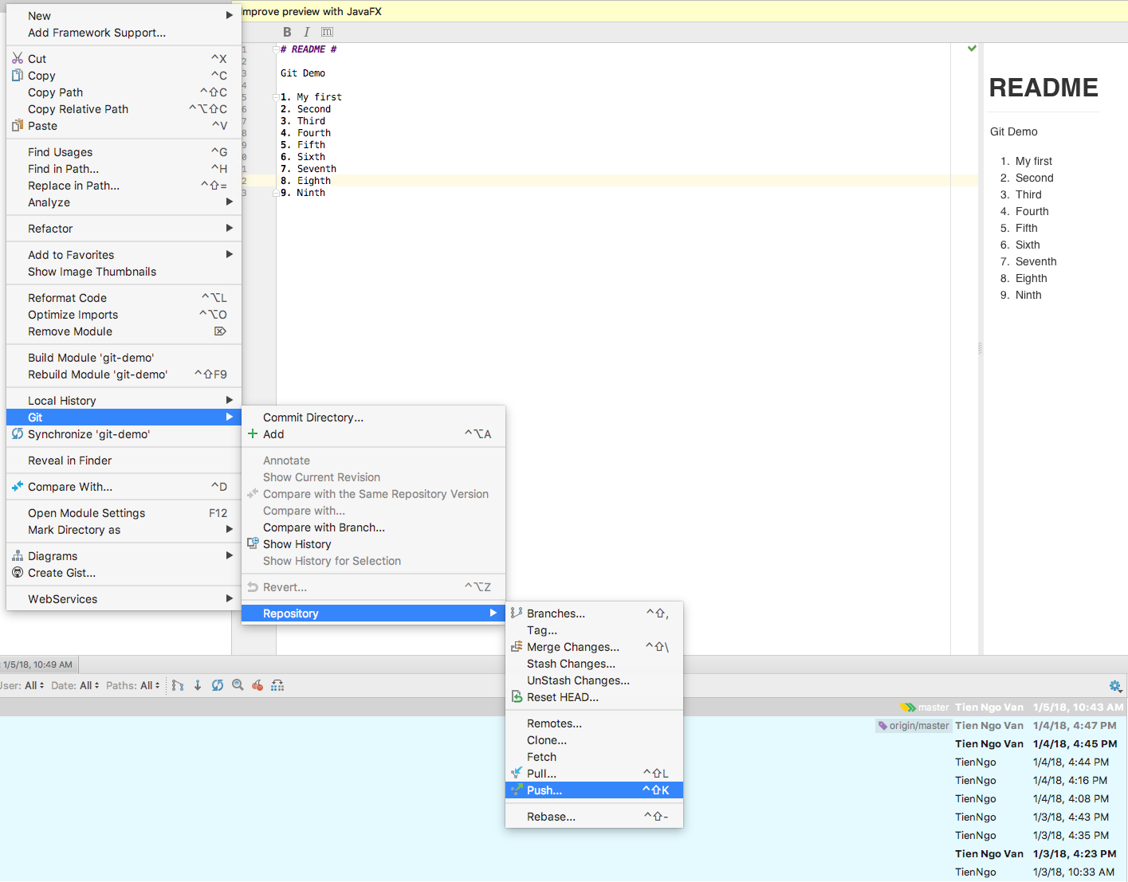
Merge
Push code to server

